Slide 1

Steps to Start a Podcast: A Comprehensive Guide
Essential steps for launching your own podcast
Notes:
AI-generated content may be incorrect. --- Podcasting has become a popular medium for sharing ideas, stories, and information. In this presentation, we will cover essential steps to help you start your own podcast, from planning and production to improving your speaking skills.

Slide 2
Planning Your Podcast
Notes:
Effective planning lays the foundation for a successful podcast. By carefully considering your podcast's purpose, audience, and structure, you can create engaging content that resonates with listeners.

Slide 3

Defining Your Podcast's Purpose and Niche
Find Your Interests
Start by pinpointing what topics energize you, as this passion is vital for sustaining interest in your podcast.
Define Your Value
Identify the unique value your podcast offers to listeners, which helps set it apart from the competition.
Set a Clear Purpose
Having a clear purpose will steer your content creation, making sure each episode meets your overarching objectives.
Notes:
Start by identifying what topics you are passionate about and what value your podcast will bring to listeners. A clear purpose and niche will help guide your content and attract a dedicated audience.

Slide 4
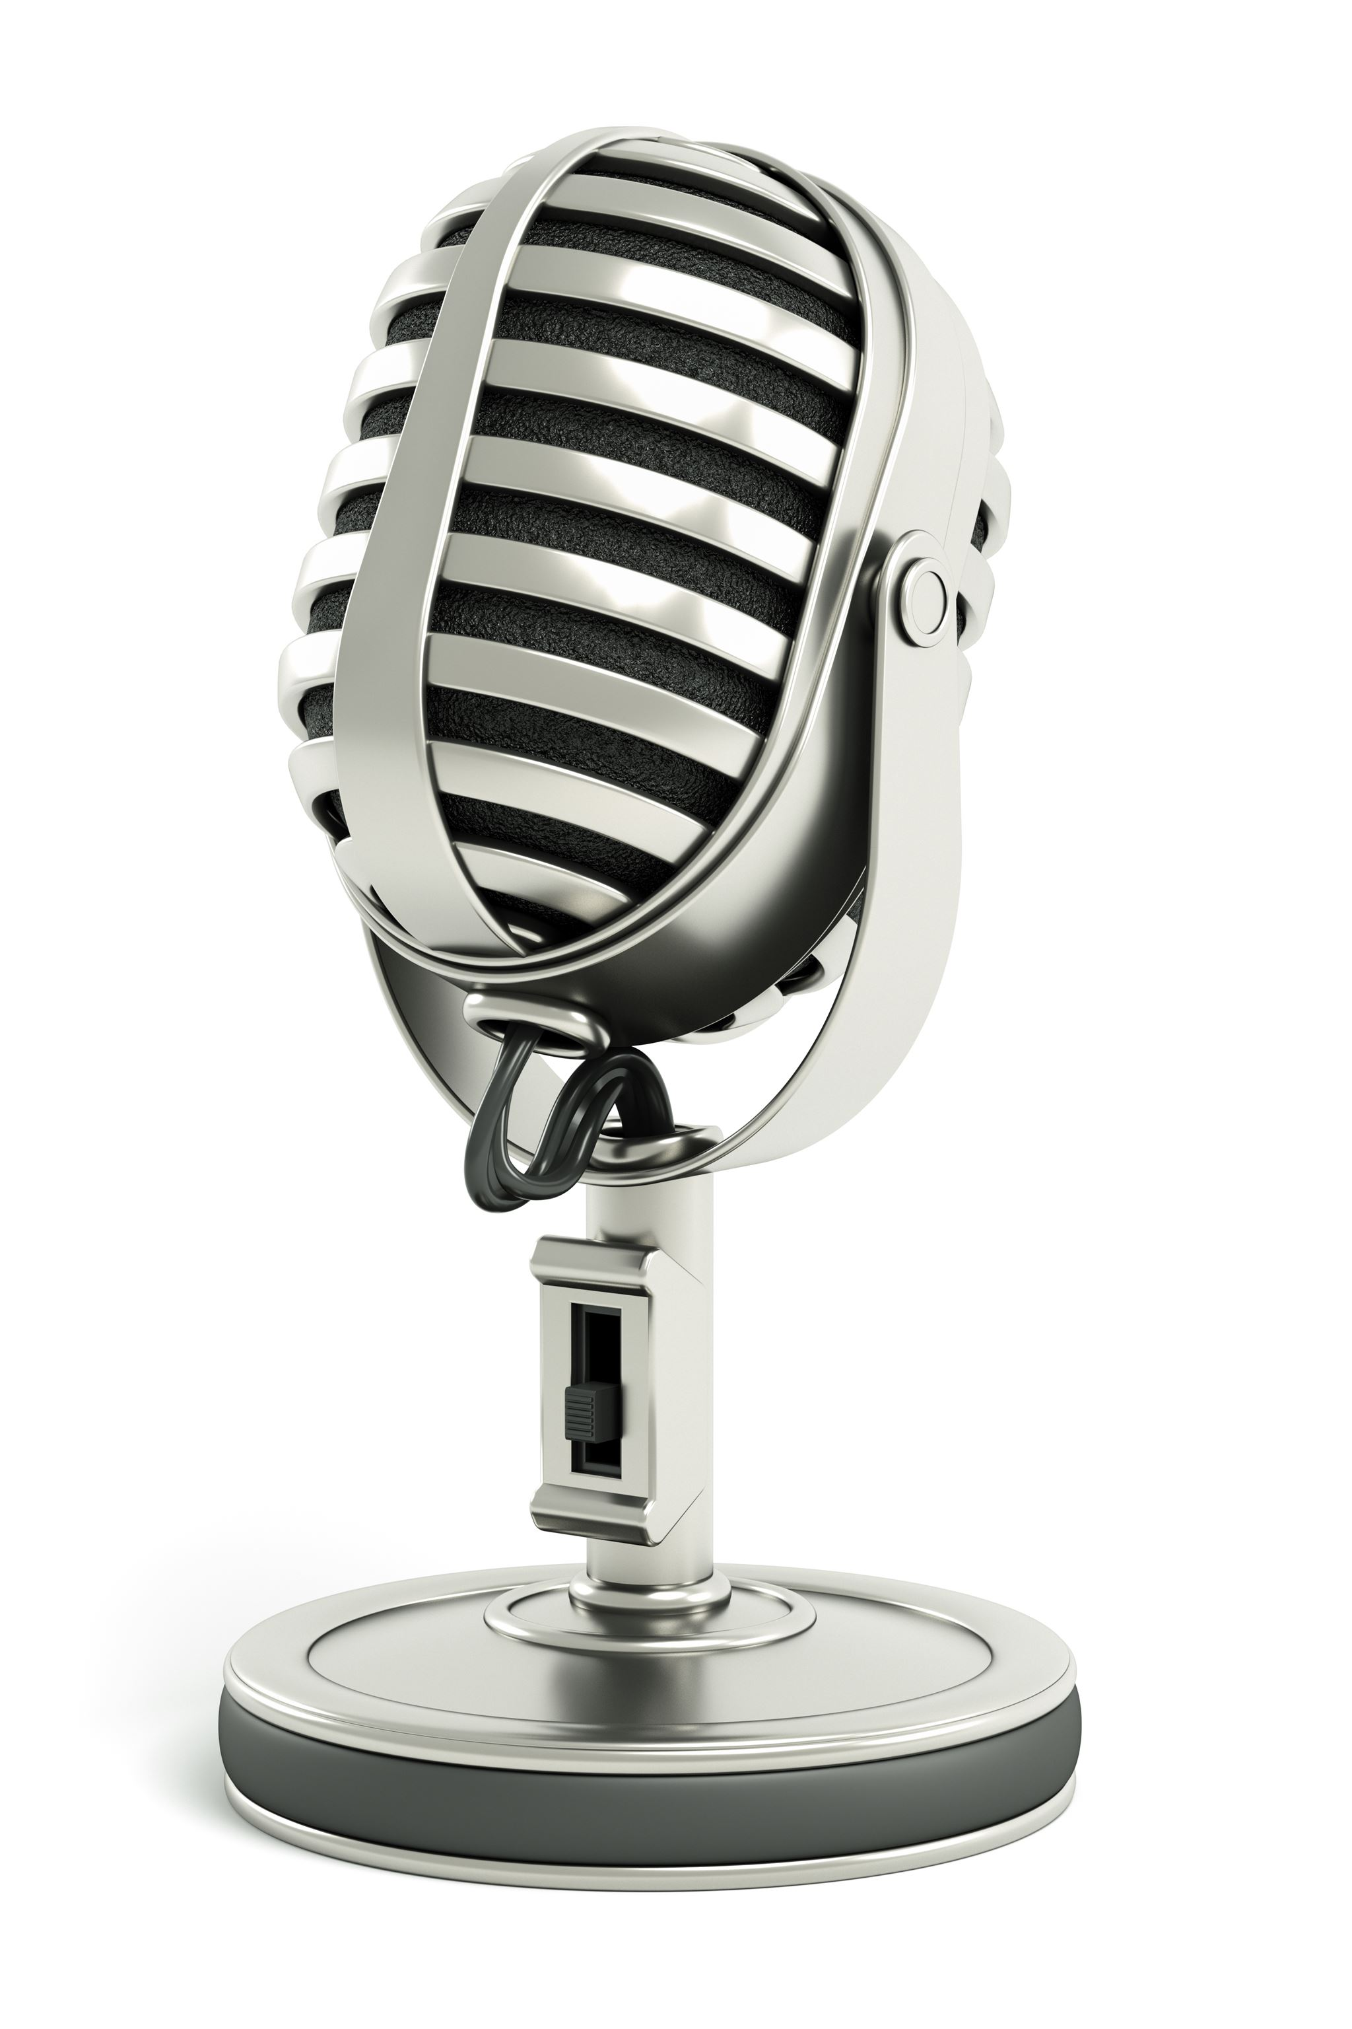
Defining Your Podcast's Purpose and Niche
Establishing a clear purpose guides content and audience engagement.
Identifying your niche helps differentiate your podcast from competitors.
Notes:
Defining your podcast's purpose and niche is crucial for success. A clear purpose not only guides your content but also strengthens audience engagement. Additionally, narrowing down your niche helps you stand out in a crowded market, allowing you to attract a dedicated listener base who resonates with your unique perspective.

Slide 5

Identifying Your Target Audience
Importance of Audience Understanding
Knowing your target audience helps in creating relevant and engaging content that resonates with them.
Research Demographics
Researching demographics allows you to tailor content based on age, gender, location, and other factors.
Identifying Interests
Understanding the interests of your audience helps in curating content that meets their preferences and needs.
Listening Habits
Analyzing listening habits enables you to determine the best formats and platforms for your content.
Notes:
Understanding your target audience is crucial for creating relevant content. Research demographics, interests, and listening habits to tailor your episodes to their preferences and needs.

Slide 6

Choosing a Podcast Format and Structure
Podcast Format Types
Choose a podcast format that suits your content, such as interview-based, narrative storytelling, or roundtable discussions.
Episode Structure
Plan the structure of each episode, including segments that create a flow and keep the audience engaged throughout.
Consistency in Release
Establish a consistent release frequency for your podcast to build an audience and maintain listener interest.
Notes:
Decide on the format of your podcast, whether it will be interview-based, narrative, or a roundtable discussion. Determine the structure of each episode, including segments, duration, and release frequency, to maintain consistency.

